Slide 1
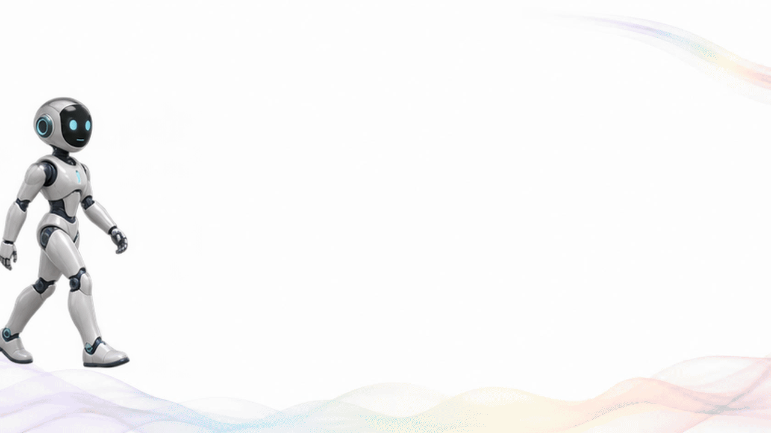
Notes:
Thank you. I look forward to your questions.
Custom animated closing: an unbranded robot walks in, turns toward the audience and gestures while Thank you appears, then bows. Silent animated GIF, 8.4 seconds, 20 frames per second, looping. Robot artwork generated with image generation and assembled into an animation. No robot name, presenter name or designation.

